Slide 1
#02 Inheritance and Polymorphism
Notes:
Give an explanation for the concepts inheritance and polymorphism
Relevant theoretical decisions
What is inheritance, when and how is it used?
How are the relationship between references and objects in an inheritance hierarchy?
What are static and dynamic types?
What is polymorphism, when and how is it used?
How do you understand the concepts early and late binding?
What is a polymorphic method?

Slide 2
Inheritance
Interdependencies and Relationships
Generalization and Specialization
writing code that is reusable
new class, ListBox, which derives from Control
Notes:
C# has two separate mechanisms for writing code that is reusable across different types: inheritance and generics.
Inheritance is used for Generalization and Specialization of code.
Classes and their instances (objects) don’t exist in a vacuum, but rather in a network of interdependencies and relationships, just as we, as social animals, live in a world of relationships and categories.
The is-a relationship is one of specialization.
Saying that ListBox inherits from (or derives from) Control indicates that it specializes Control. Control is referred to as the base class, and ListBox is referred to as the derived class.
This code declares a new class, ListBox, which derives from Control. You can read the colon as “derives from.”

Slide 3
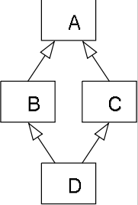
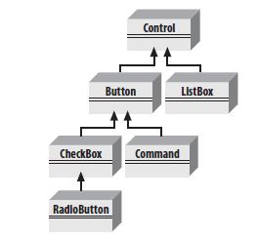
Hierarchy and Single Inheritance
C# does not allow multiple inheritance, but does allow implementing multiple interfaces
Semantic ambiguity
Notes:
In object-oriented programming languages with multiple inheritance and knowledge organization, the diamond problem is an ambiguity that arises when two classes B and C inherit from A, and class D inherits from both B and C. If a method in D calls a method defined in A (and does not override the method), and B and C have overridden that method differently, then from which class does it inherit: B, or C?

Slide 4
Static and Dynamic
Static
Compile-time type checking
Early type checking
Types are variables
Dynamic
Runtime type checking
Types are values
C# is a statically type language, but in C# 4.0 it is possible to bypass type checking
Notes:
Assigning data types (typing) gives meaning to collections of bits.
Static: A programming language is said to use static typing when type checking is performed during compile-time as opposed to run-time. In static typing, types are associated with variables not values. Static typing is a limited form of program verification (see type safety): accordingly, it allows many type errors to be caught early in the development cycle. Program execution may also be made more efficient (i.e. faster or taking reduced memory) by omitting runtime type checks and enabling other optimizations.
Dynamic: A programming language is said to be dynamically typed, when the majority of its type checking is performed at run-time as opposed to at compile-time. In dynamic typing, types are associated with values not variables. Compared to static typing, dynamic typing can be more flexible (e.g. by allowing programs to generate types and functionality based on run-time data), though at the expense of fewer a priori guarantees.

Slide 5
Late Binding
Also know as Dynamic Binding
Allow substitution of an implementation using the same interface
C# supports late binding making it possible to use polymorphism
Notes:
In object oriented programming, dynamic binding means determining the exact implementation of a request based on both the request (operation) name and the receiving object at the run-time. It often happens when invoking a derived class's member function using a pointer to its super class. The implementation of the derived class will be invoked instead of that of the super class. It allows substituting a particular implementation using the same interface and enables polymorphism.
Suppose all life-forms are mortal. In object oriented programming, we can say that the Person and Plant classes must implement the Mortal interface, which contains the method die().
Persons and Plants die in different ways; for example, Plants do not have hearts that stop. Dynamic binding is the practice of figuring out which method to invoke at runtime.

Slide 6
Polymorphism
Many forms
A Class can be used as more the one type
Its own type
Base type
Any interface type it implements (if any)
Implemented via Inheritance or Interface
Notes:
There are two powerful aspects to inheritance. One is code reuse. When you create a ListBox class, you’re able to reuse some of the logic in the base (Control) class. What is arguably more powerful, however, is the second aspect of inheritance: polymorphism. Poly means “many” and morph means “form.” Thus, polymorphism refers to being able to use many forms of a type without regard to the details.
Through inheritance, a class can be used as more than one type; it can be used as its own type, any base types, or any interface type if it implements interfaces. This is called polymorphism. In C#, every type is polymorphic and all object references in C# are potentially polymorphic.
Polymorphism is important not only to the derived classes, but to the base classes as well. Anyone using the base class could, in fact, be using an object of the derived class that has been cast to the base class type. Designers of a base class can anticipate the aspects of their base class that are likely to change for a derived type. For example, a base class for cars might contain behavior that is subject to change when the car in question is a minivan or a convertible. A base class can mark those class members as virtual, allowing derived classes representing convertibles and minivans to override that behavior.
For example, a form might want to keep a collection of all the instances of Control it manages so that when the form is opened, it can tell each of its Controls to draw itself. For this operation, the form doesn’t want to know which elements are listboxes and which are buttons; it just wants to tick through its collection and tell each to “draw.” In short, the form wants to treat all its Control objects polymorphically.

Slide 7
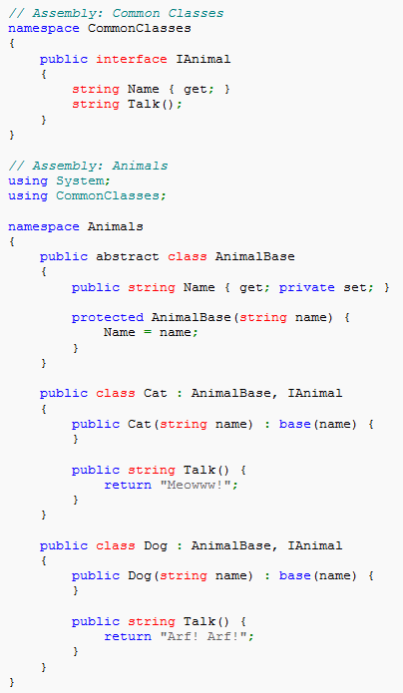
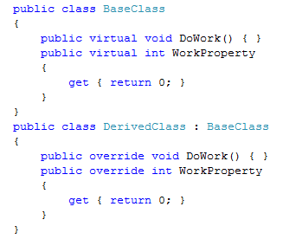
Polymorphism
Notes:
In order for an instance of a derived class to completely take over a class member from a base class, the base class has to declare that member as virtual. This is accomplished by adding the virtual keyword before the return type of the member. A derived class then has the option of using the override keyword, instead of new, to replace the base class implementation with its own. For example:

Slide 8
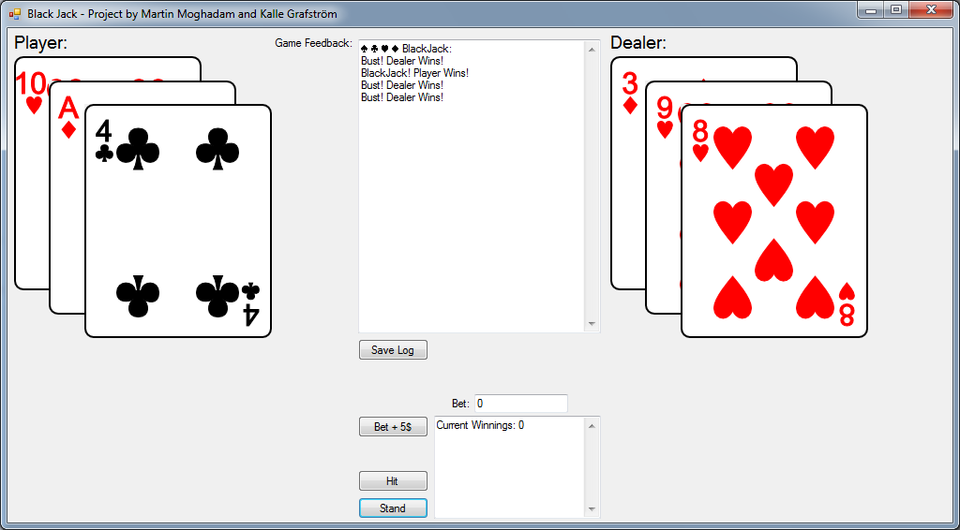
Our program
Black Jack Game
Log
Save Log
Beting
Hit
Stand

Slide 9
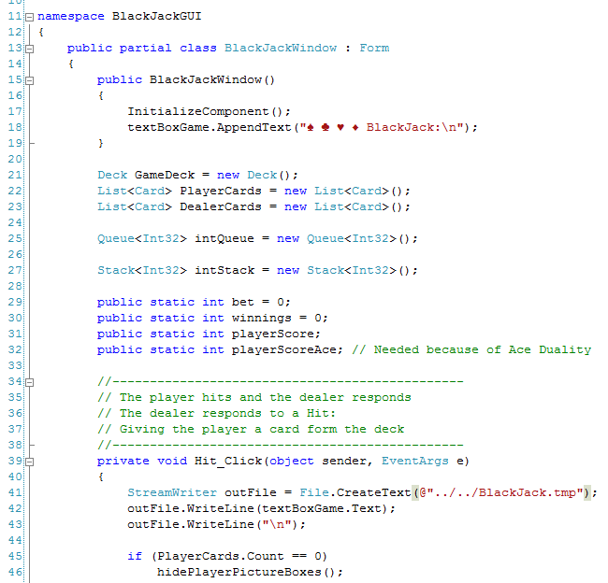
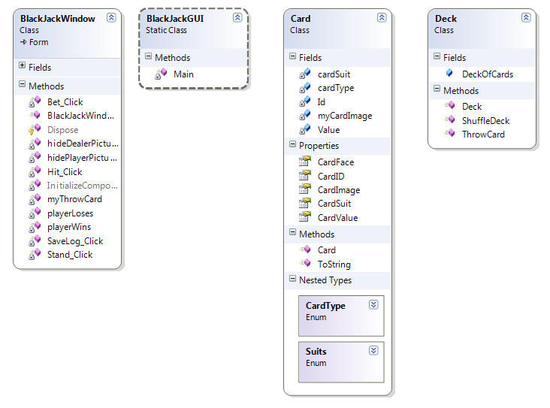
Our program
Notes:
Our application contains a simple card class, and a deck class.
A deck of cards is a list that contains objects of the type card.

Slide 10
Questions?

